Slide 1
Dr. Maher jabbar salih
Medical oncologist
Al-basrah onco. Centre
Leturer at al-basrah medicine college
November - 2023

Slide 5
Lung diseases :
1-Obstructive lung diseases(COPD, asthma ,bronchectasis , cystic fibrosis )
2-restrictive lung dis…lung fibrosis
3-infections
4-tumors
5-pulmonary vascular dis.

Slide 6
Obstructive lung diseases
1-COPD,
2-asthma ,
3-bronchectasis ,
4-cystic fibrosis (not lung fibrosis ) .

Slide 7
Asthma
Asthma : is a lower respiratory tract disease ; it is a pulmonary obstructive disease.It is also called as “REACTIVE AIRWAY DISEASE
Chronic inflammation is associated with airway hyper-responsiveness that leads to recurrent episodes of wheezing, breathlessness, chest tightness and coughing, particularly at night and in the early morning.
Asthma is the most common chronic disease among children

Slide 9
Pathophysiology
Airway hyper-reactivity (AHR) – the tendency for airways to narrow excessively in response to triggers that have little or no effect in normal individuals – is integral to the diagnosis of asthma and appears to be related, although not exclusively, to airway inflammation .
Other factors likely to be important in the behaviour of airway smooth muscle include the degree of
airway narrowing and neurogenic mechanisms.

Slide 10
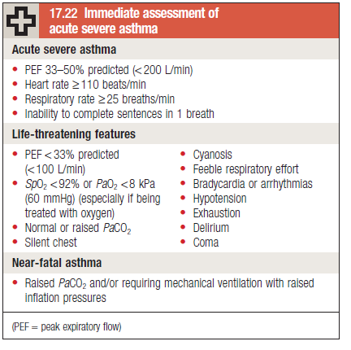

Slide 11
Treatment :
Quick relief (rescue) medications
1-Short-acting beta agonists..salbutamol
2-Ipratropium
3-Oral and intravenous corticosteroids…hydrocortison

Slide 12
Long term relief :
LABA…..long acting Beta agonist.
LTRA…leukotrine inhibitors
Theophylline .
steroids …prednisolone .

Slide 13
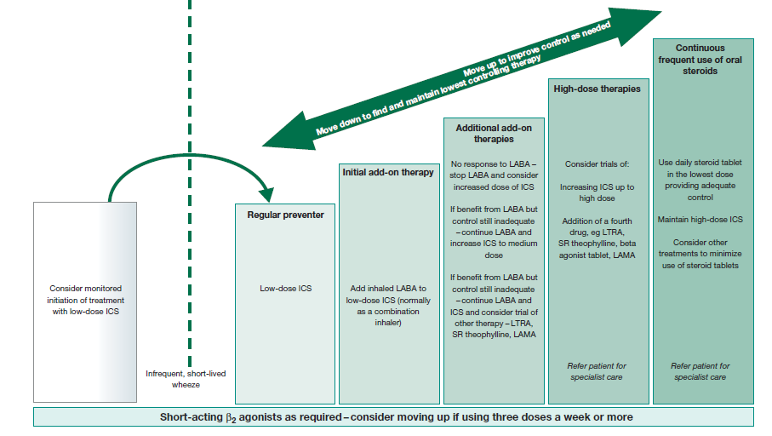

Slide 14
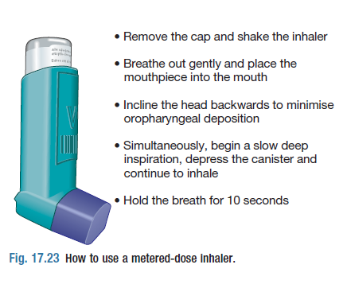

Slide 15
COPD TREATMENT :
1- QUIT SMOKING
2- BRONCHIDILATORS
3- ANTIBIOTICS +_ STEROIDS
4- OXYGEN SUPPLY ?
5- SURGERY ?

Slide 17
Thanks a lot …

Slide 20
